Slide 1
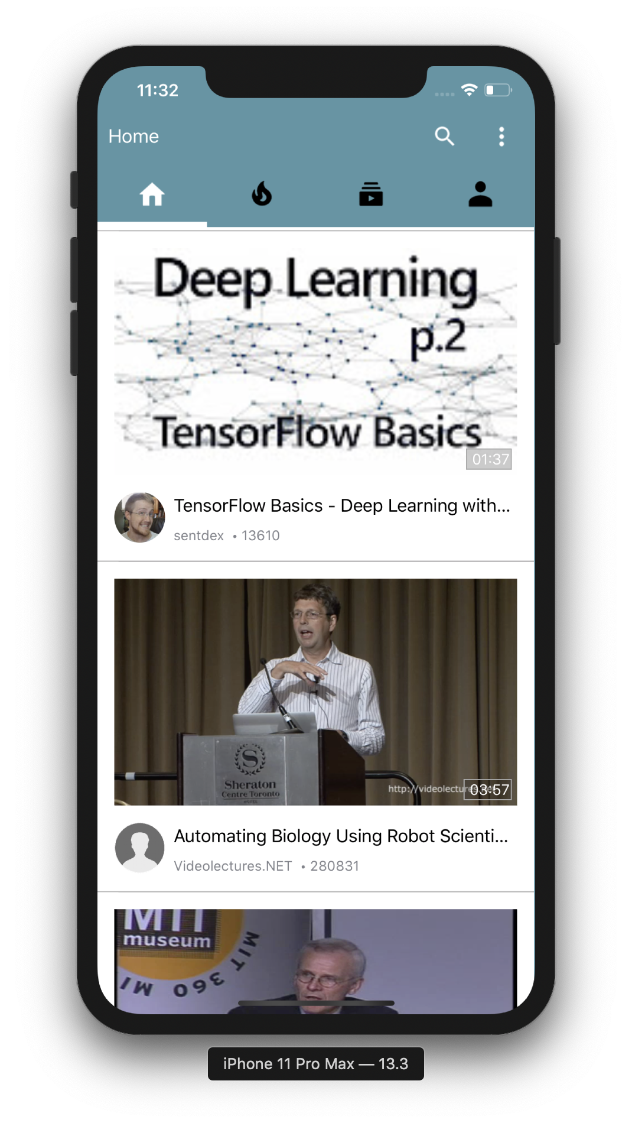

Team 4 : Patrick Wu, Yinrui Hu

Slide 2

Introduction
Abstract
Technology
X5GON is an industrial leading Open Education Resource Provider. In this project, we worked with the UCL X5GON research team to deliver a mobile application that a Mobile Application that provides users with an authentic and mobile-friendly X5GON experience and learning materials catered for their needs.
With this project, the X5Learn system would be able to attract more users from the mobile platform, and enable them to learn anything anywhere.
We used Swift as our main language, Xcode and its toolchains as our SDK in our project.
We designed our software architecture with the classic MVC Model.
We utilized design patterns including Prototype Pattern, Adapter Pattern and Builder Pattern.

Slide 3
Achievement
ID | Description | Priority | State | Contributors
1 | View all types of OER | Must | ✖️
2 | Suggest relevant OERs and show them below the OER that is currently on display | Must | ☑️ | Patrick Wu
3 | Play or pause an OER video | Must | ✖️
4 | View a specific OER and its details when they press it | Must | ☑️ | Patrick Wu
5 | Bookmark a specific OER | Must | ✖️
6 | Add notes to the OER when they are on display | Must | ✖️
7 | Show the person or organisation who uploads the OER material | Must | ☑️ | Patrick Wu

Slide 4
Achievement
ID | Description | Priority | State | Contributors
8 | Search inside X5GON OER collections for keywords | Must | ☑️ | Patrick Wu
9 | View their browsing history | Must | ✖️
10 | Full screen (focus) mode to view OERs | Must | ✖️
11 | Rate an OER by pressing the like and dislike button | Must | ☑️ | Patrick Wu
12 | Login and logout of their accounts. | Should | ✖️
13 | Buffer users’ notes for a specific OER and send them to the backend of X5GON. | Should | ✖️
14 | Preload the video shown on the lists for responsiveness. | Should | ☑️ | Patrick Wu

Slide 5
Achievement
ID | Description | Priority | State | Contributors
15 | Allow users to add captions to the audio and video | Should | ✖️
16 | Provide different main pages, including trending, subscribed contents. | Should | ✖️
17 | Record and store users’ browsing history anonymously. | Should | ✖️
18 | Create a simulated backend to pre-develop certain features | Should | ✖️
19 | Provide different functions to different privileged accounts. | Could | ✖️
20 | Help improve the X5GON platform and backend if time permits | Could | ✖️
21 | Deploy this software on different platforms, e.g. Android | Could | ✖️

Slide 6
Achievement
ID | Description | Priority | State | Contributors
22 | Allow users to report inappropriate content | Could | ✖️
23 | Allow users to change the resolution of the video | Could | ✖️
24 | Auto translate the captions | Won’t
25 | Allow users to upload OER from our app | Won’t
26 | Allow users to collaborative edit notes | Won’t
27 | Allow commenting on OER | Won’t
28 | Show users’ note to other users | Won’t
29 | Keep suggesting the same OER to same user | Won’t
Key Functionalities: |  |  | 45%
Optional Functionalities: |  |  | 8%

Slide 7
Contribution
Part Of Project | Patrick Wu | Yinrui Hu
Client Liaison | 70% | 30%
Requirement Analysis | 60% | 40%
Research | 100% | 0%
UI Design | 60% | 40%
Programming | 100% | 0%
Testing | 50% | 50%
Bi-Weekly Reports | 60% | 40%
Project Website | 80% | 20%
Demo Video | 70% | 30%
Prototyping | 50% | 50%
 | Patrick Wu | Yinrui Hu
Overall Contribution | 70.0% | 30.0%
Main Roles | Lead Developer, Researcher | Tester, UI Designer, Video Editor

